Slide 1

TOPIC
Machine Learning based on Survival Prediction Model for Heart Failure Patients
Keywords: Machin Learning、Classification algorithm、Neural Network、5-fold cross validation
DESINGER：Qinhan Yu (Queena)
Jie Lu (Sonia)
TIME：2022.1.29

Slide 2

01
Introduction
02
Methodology
03
Result
04
C O N T E N T S
Discussion
05
Conclusion
06
Reference
07
Contribution

Slide 3
01
Introduction
Introduction

Slide 4

Introduction
Medical background
Cardiovascular disease has become a disease with a high prevalence, about 17 million people die from cardiovascular every year in world
Status and causes
The medical community doesn’t have a full grasp of the causes, so machine learning is employed to highlight undetected factors and correlations
What we do
Use unsupervised learning to compare classified situation & classification algorithm that are decision trees, logistic regression and neural networks to train and test dataset, and compare models
Comparing the results of model training to obtain models with higher accuracy and more accurate detection of factors causing heart failure.

Slide 5
02
Methodology
Methodology

Slide 6

Data Source
Data Source
Data Attribute
UCI Maching Learning Repository
- Heart failure clinical records Data Set
- age: age of the patient (years)
- anaemia: decrease of red blood cells or hemoglobin
(boolean)
- high blood pressure: if the patient has hypertension (boolean)
- CPK : level of the CPK enzyme in the blood (mcg/L)
- diabetes: if the patient has diabetes (boolean)
- ejection fraction: percentage of blood leaving the heart at each
contraction (percentage)
- platelets: platelets in the blood (kiloplatelets/mL)
- sex: woman or man (binary)
- serum creatinine: level of serum creatinine in the blood (mg/dL)
- serum sodium: level of serum sodium in the blood (mEq/L)
- smoking: if the patient smokes or not (boolean)
- time: follow-up period (days)
- [target] death event: if the patient deceased during the follow-up
period (boolean)
Data Overview
Number of Instances: 299
Number of Attributes: 13
Date Donated: 2020-02-05
Associated Tasks: Classification, Clustering

Slide 7
Method summary
First of all, we analysis the general situation of the data through pandas-filing package.
Then adjust the distribution of continuous variables.
Finally carry out correlation analysis and chi-test, and complete data preprocessing at the same time.
EDA
Exploratory Data Analysis
Cluster Analysis
Decision Tree
Logistic Regression
Neural Network
Build the Model
5-fold cross validation
Receiver operating characteristic curve(ROC)
Evaluate the Model
Programming Language：Python & Pytorch

Slide 8
03
Result
Result

Slide 9
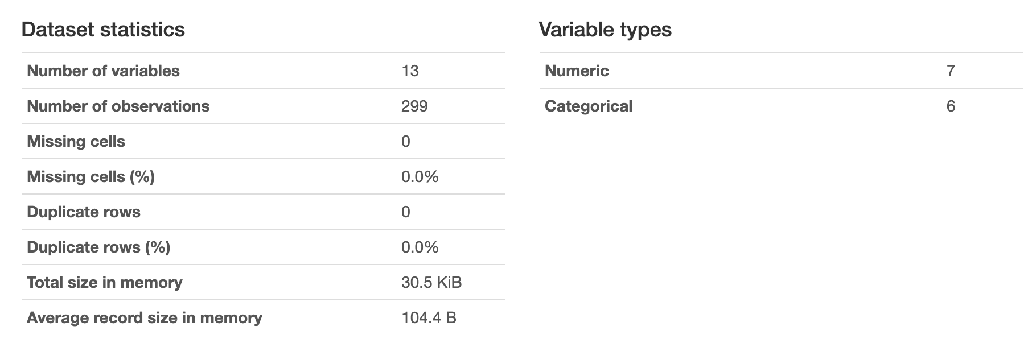
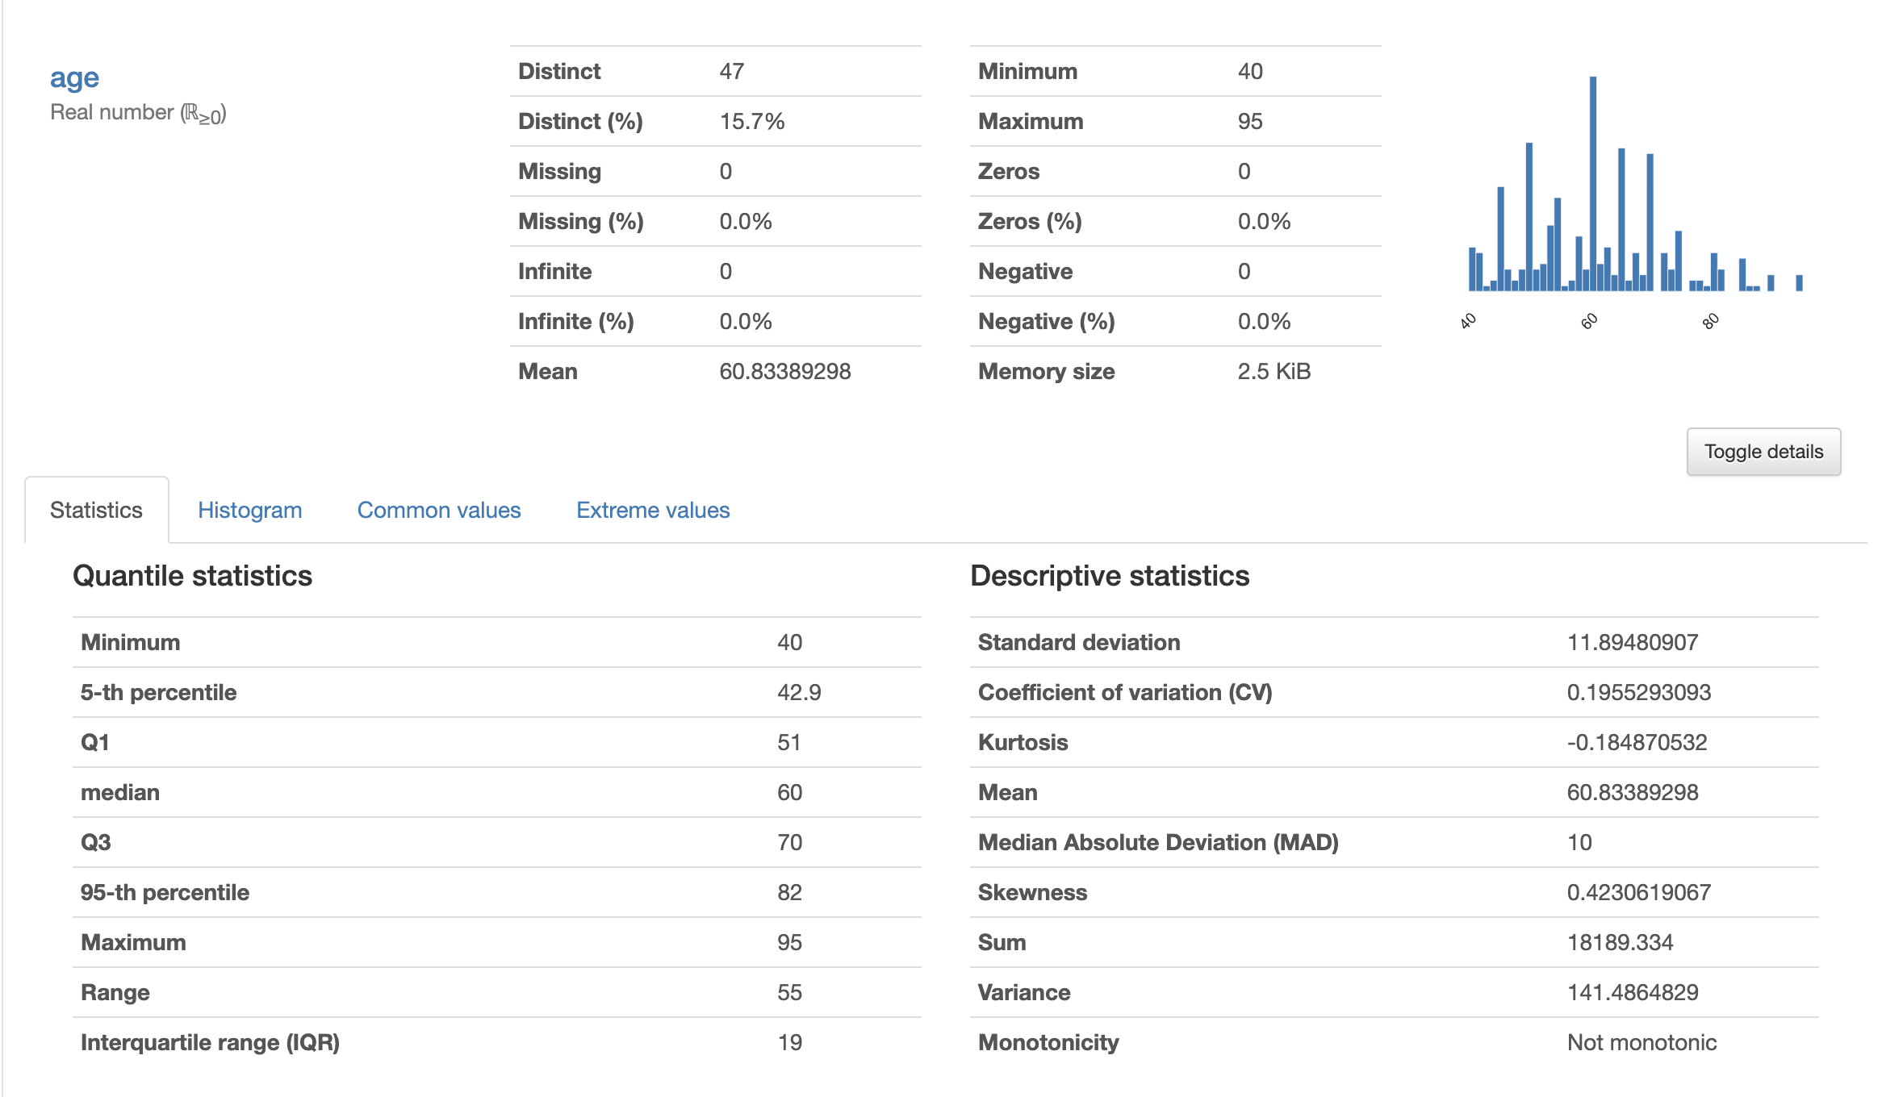
EDA
1. Basic information of data
— Using pandas-profiling
An example
Box-Cox transformation
There is no missing value.
The mean value, maximum value, minimum value and so on of each variable can be obtained.

Slide 10
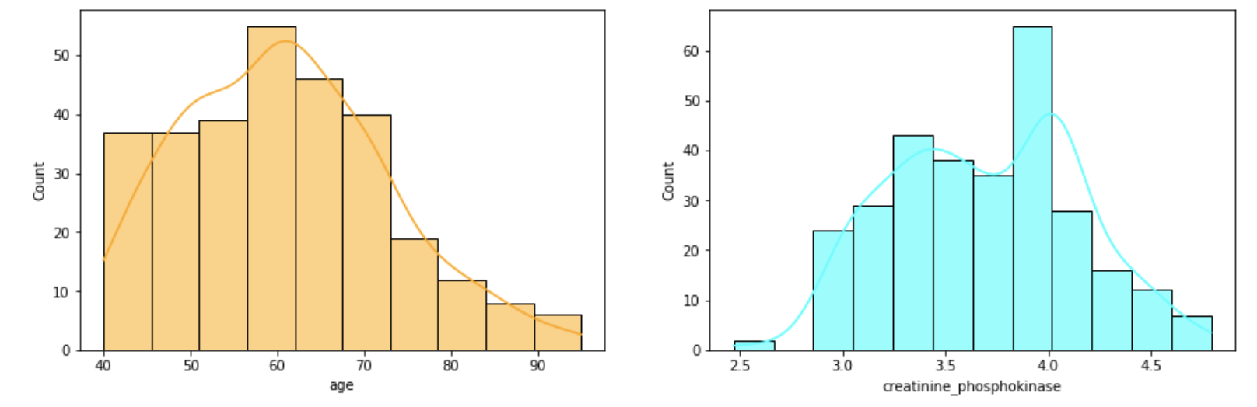
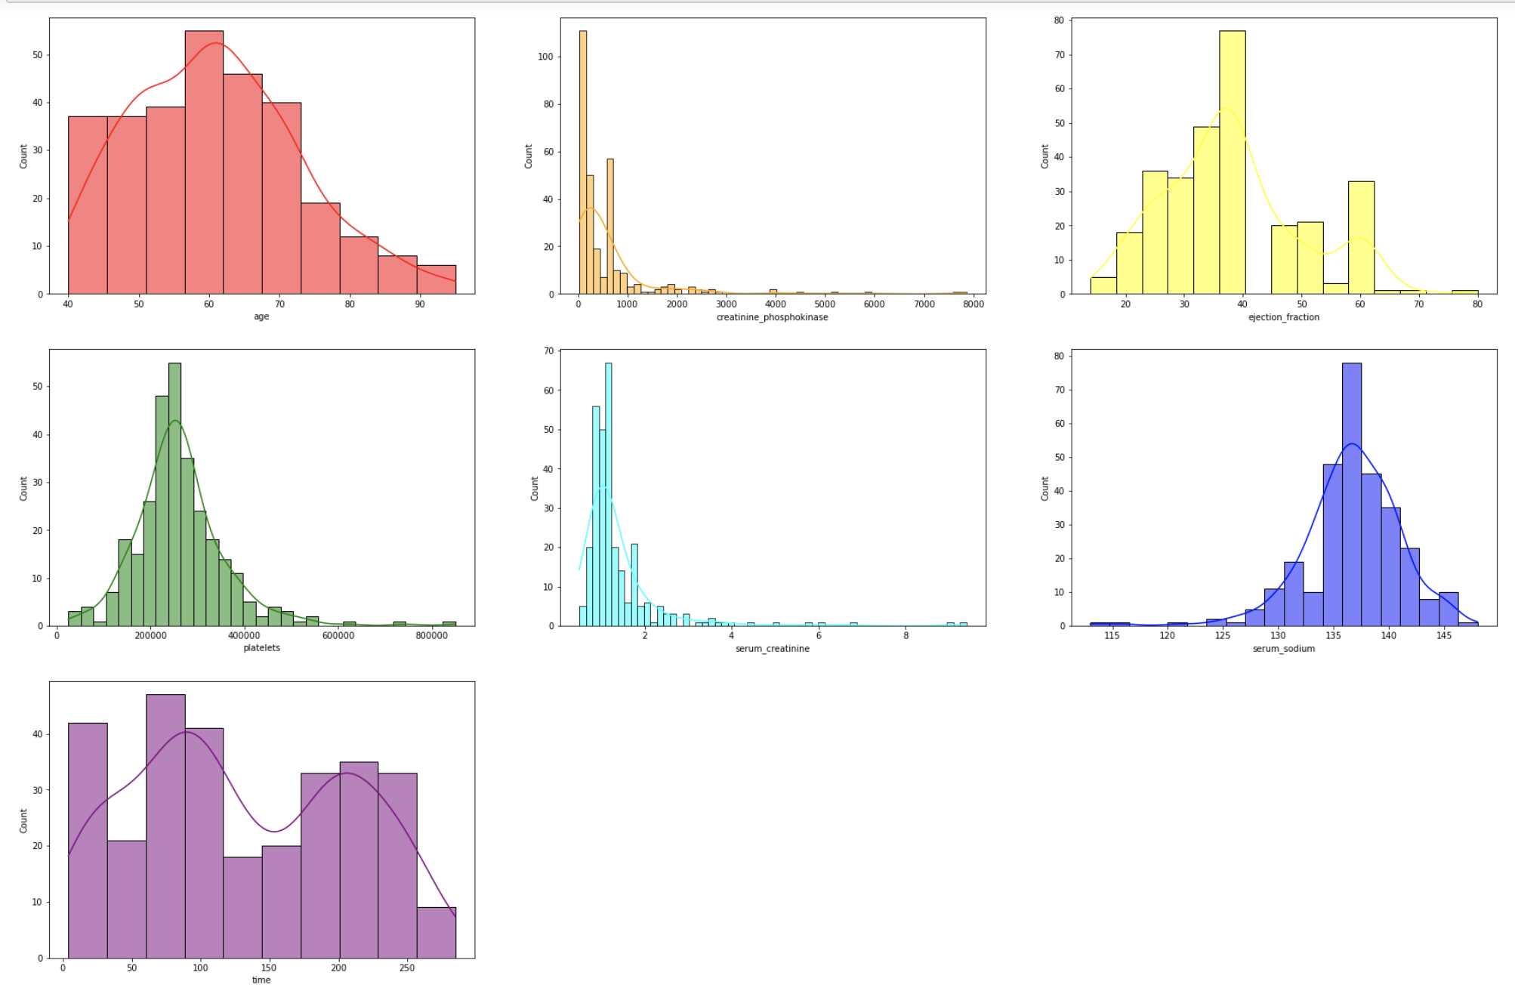
EDA
2. Viewing the distribution of continuous variable
—Data Preprocessing
Box-Cox transformation

Slide 11
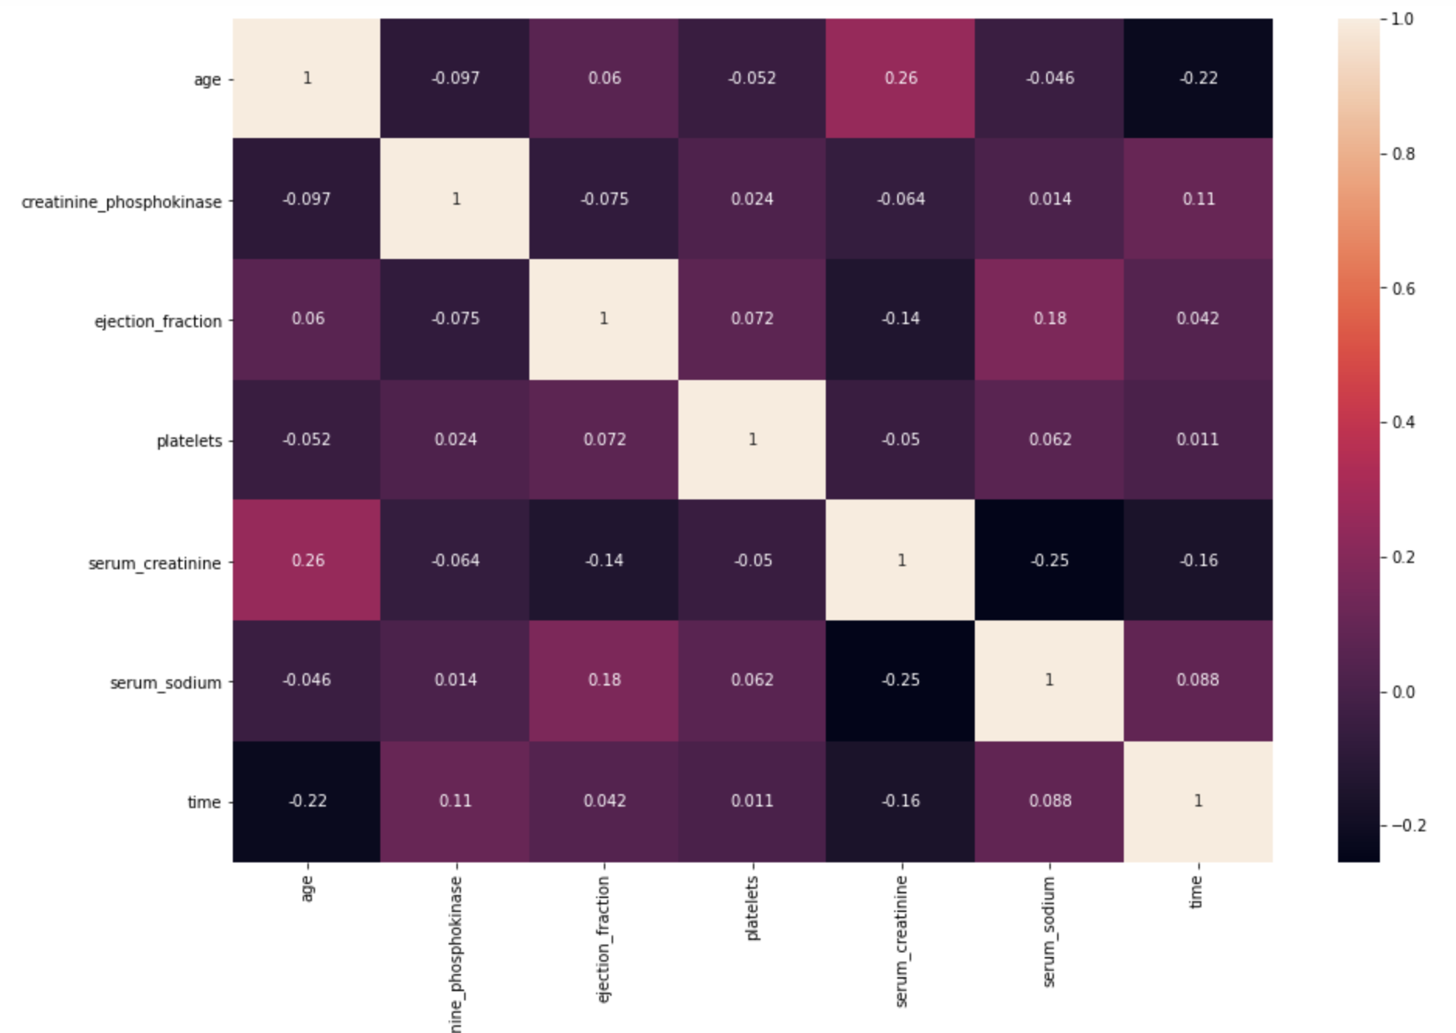
EDA
3. Bi-variate Analysis
- Correlation Analysis for continue variablies

Slide 12
EDA
3. Bi-variate Analysis
- Test of significance between
categorical variables and continues variables
- Chi test
 | anaemia | diaetes | high_blood_pressure | sex
smoking | 0.1618 | 0.0522 | 0.4378 | 4.8999e-06
smoking & diaetes & sex
When building the model, we can choose to leave only the smoking column to simplify the model.

Slide 13
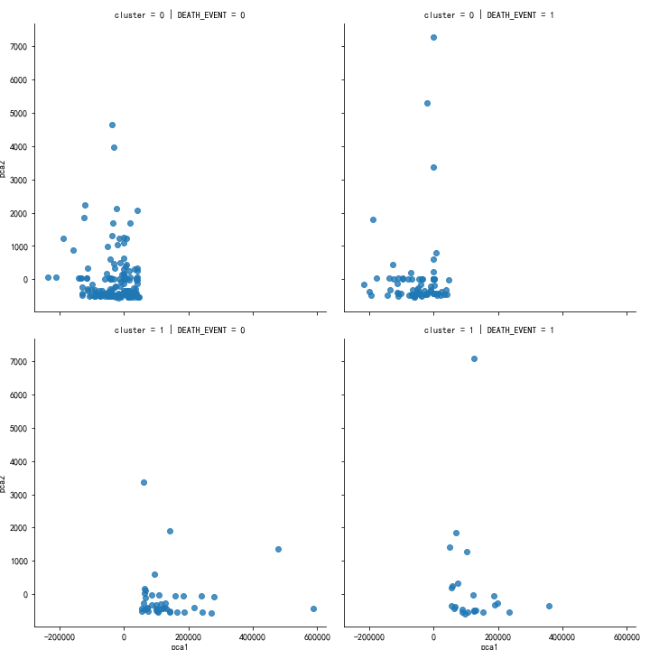
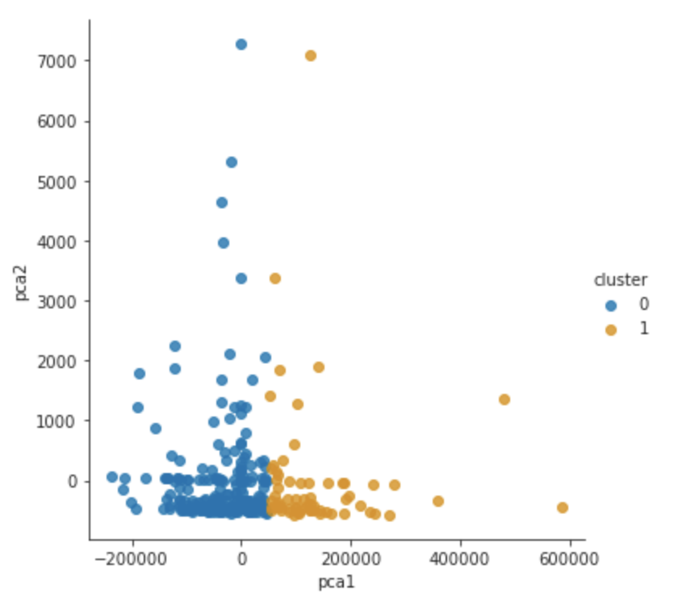
Build the Model
Clustering
Compared with dataset
Cluster
Analysis
-Unsupervised learning
There should be two of them that are not available.
The result is not optimistic.

Slide 14
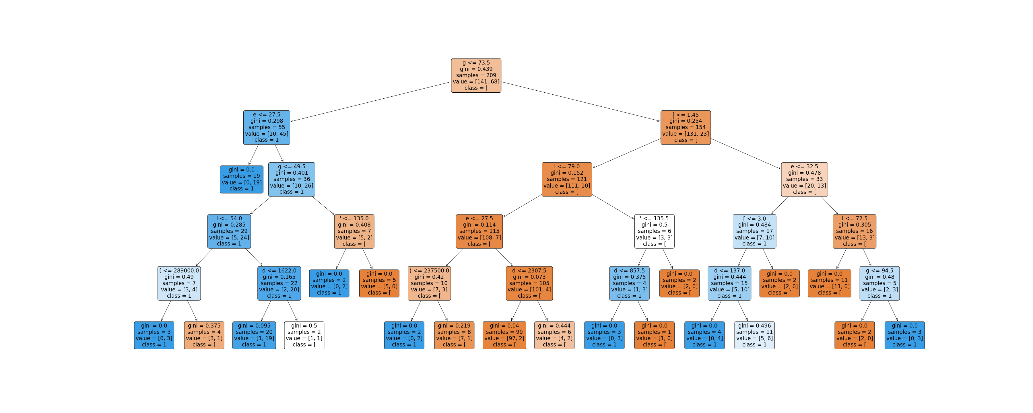
Build the Model
Train set score: 0.937799043062201
Test set score：0.833333333334
Visual tree diagram(max_depth=5)
Decision
Tree

Slide 15
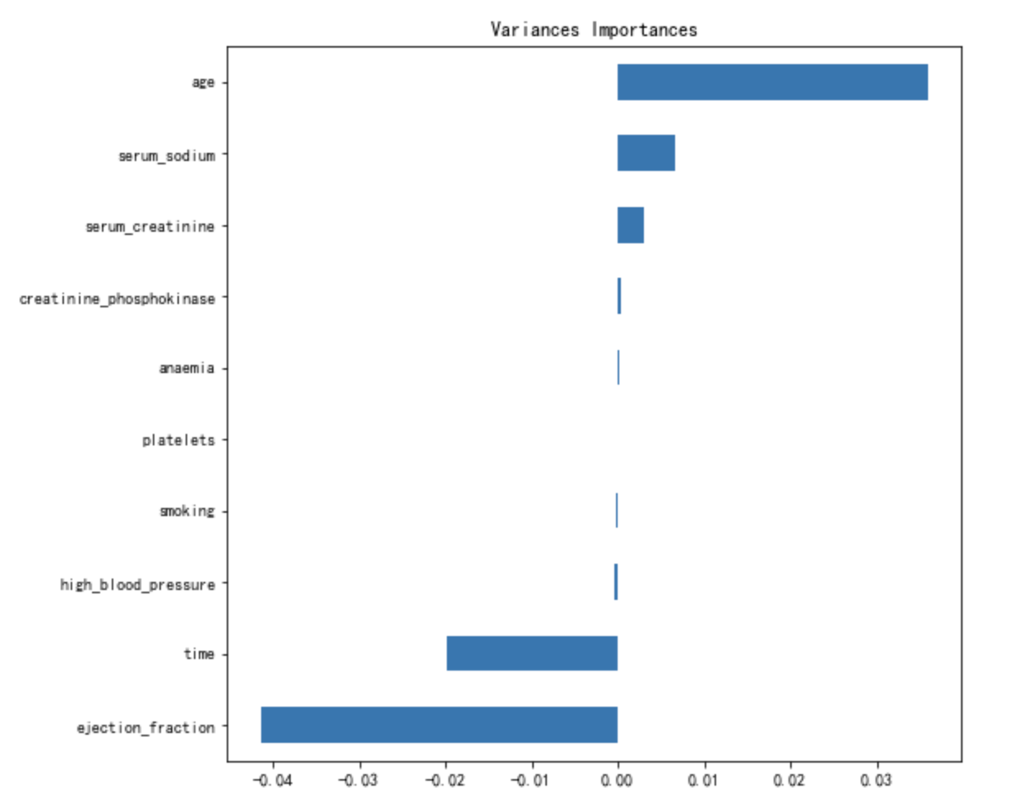
Build the Model
Train set score: 0.8421052631578947
Test set score: 0.8333333333333334
Variances Importances
Logistic Regression

Slide 16
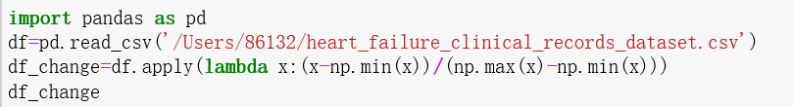
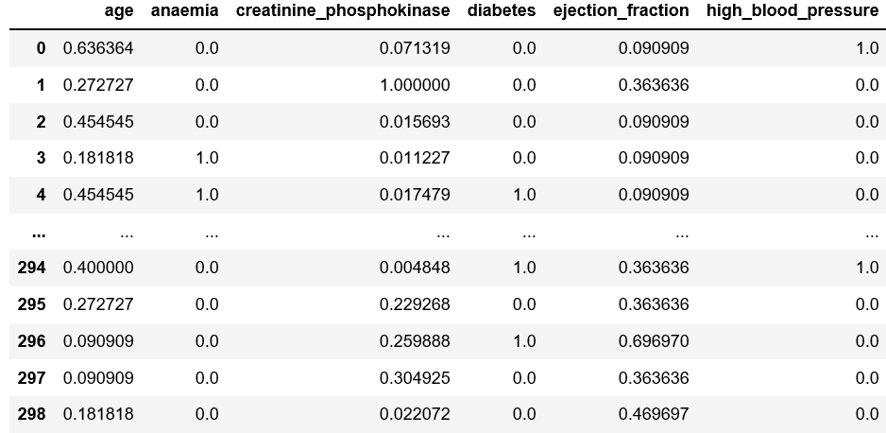
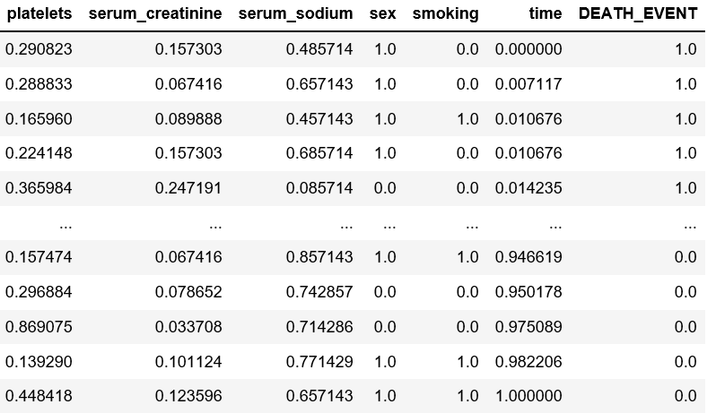
Build the Model
Full connected neural network

Slide 17
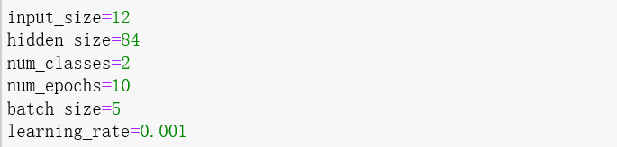
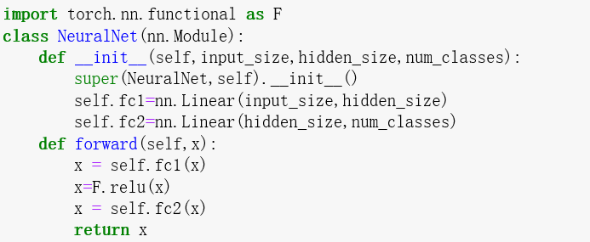
Build the Model
Fully connected neural network(one hidden layer)

Slide 18
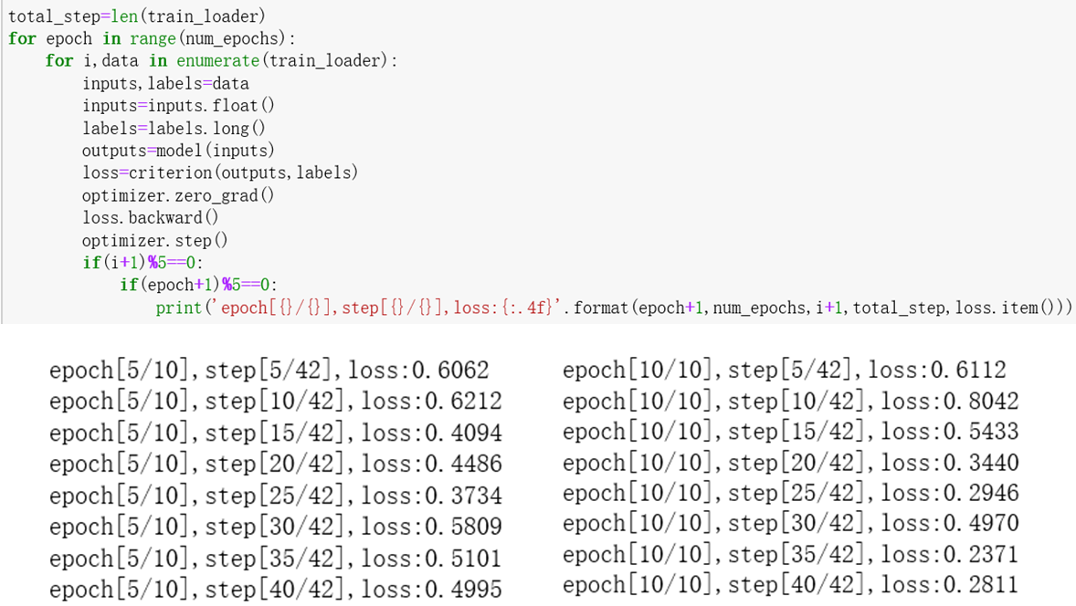
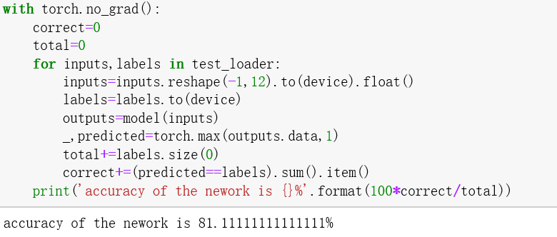
Build the Model
Fully connected neural network(one hidden layer)
Accuracy of test set: 81.11111%

Slide 19
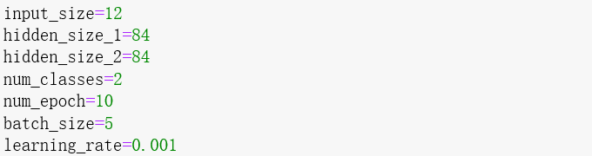
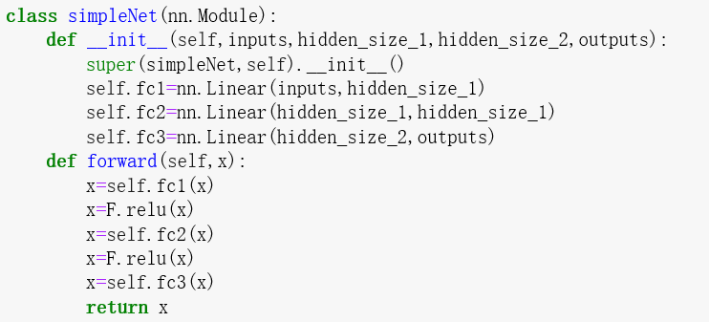
Build the Model
Fully connected neural network(two hidden layers)

Slide 20
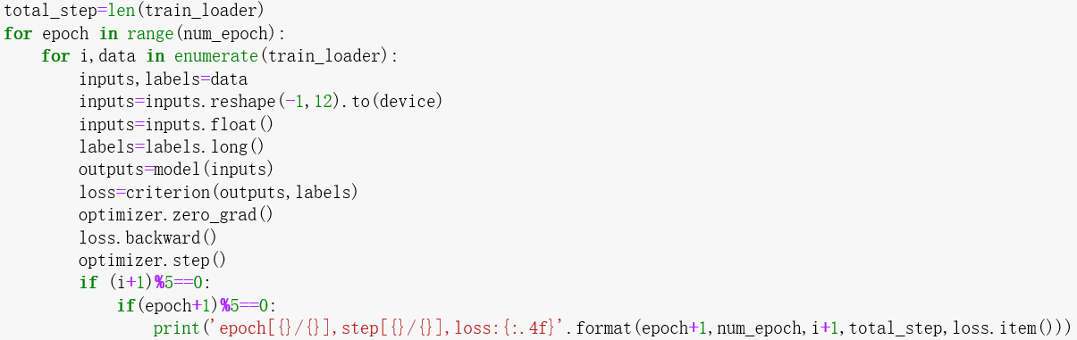
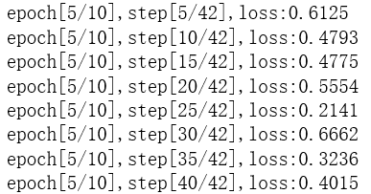
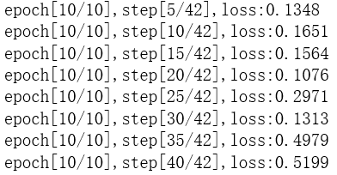
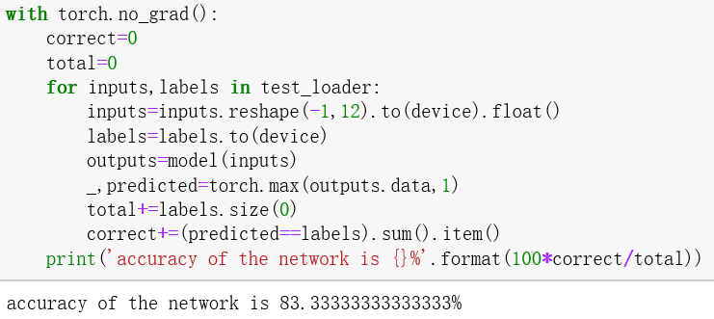
Build the Model
Fully connected neural network(two hidden layers)
Accuracy of test set: 83.333333%

Slide 21
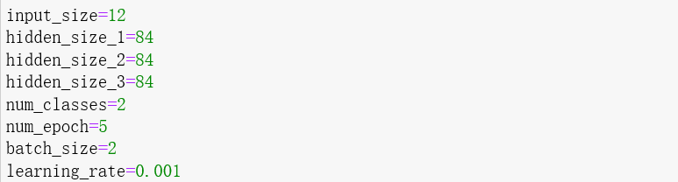
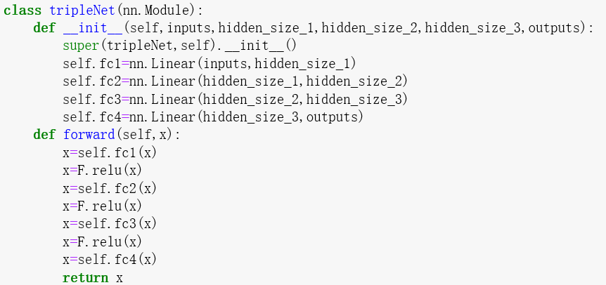
Build the Model
Fully connected neural network(three hidden layers)

Slide 22
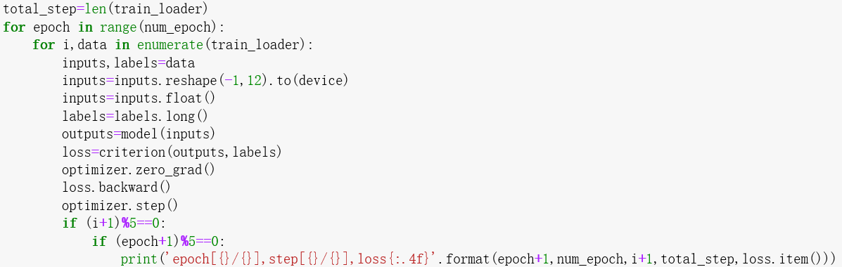
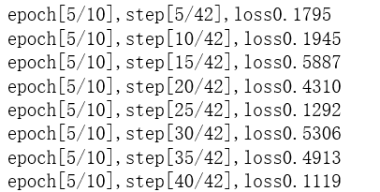
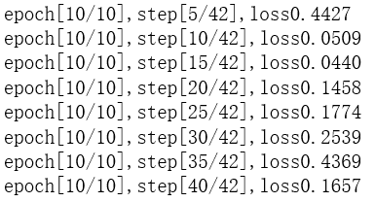
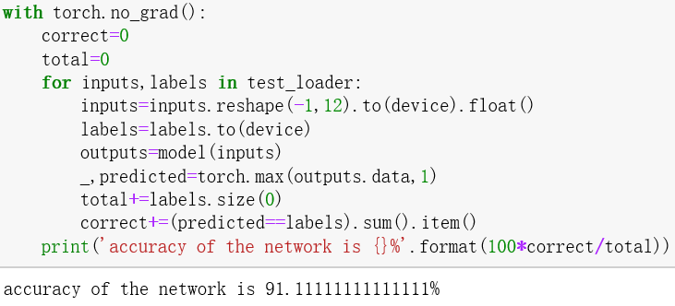
Build the Model
Fully connected neural network(three hidden layers)
Accuracy of test set: 91.11111%

Slide 23
04
discussion
discussion

Slide 24
Discussion
1、Accuracy Rate—5-fold cross validation
Decision tress — 78.929%
Logistic — 82.2742 %
FC neural network— 96.6667%

Slide 25
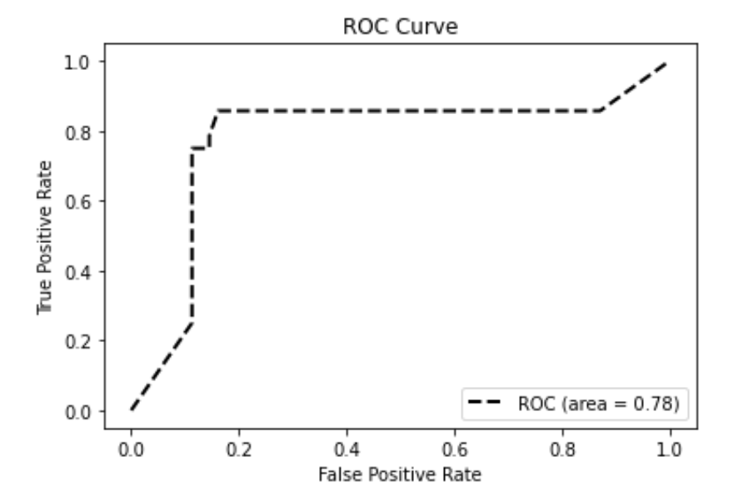
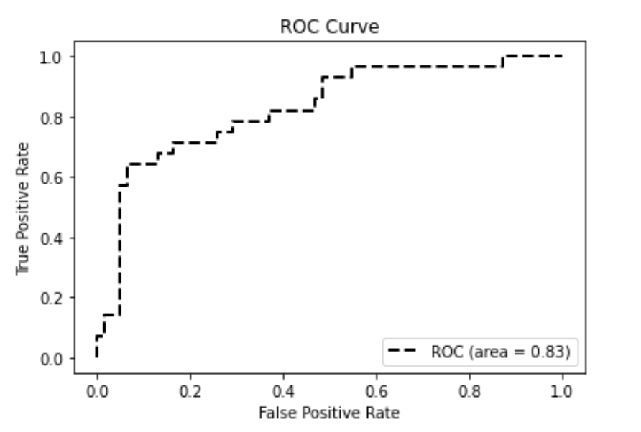
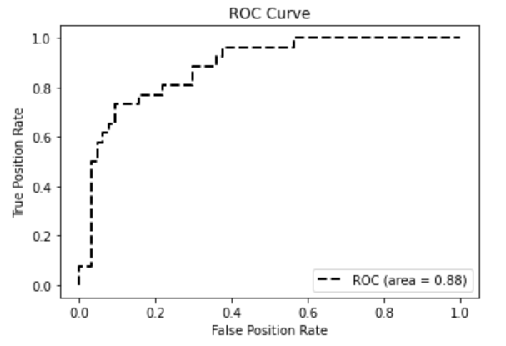
Discussion
2、ROC curve
Decision tress | Logistic Regression | Fully connected neural network
0.78 | 0.83 | 0.88

Slide 26
05
Conclusion
Conclusion

Slide 27
Conclusion
All of the models we showed presents good predictive ability (they were all more than 80% accurate)
Comparing the three types of models: decision tree, logistic regression and fully connected neural network, the fully connected neural network is more accurate and true
For a fully connected neural network, the more the number of hidden layers, which means the more complex the model, the more realistic the prediction of the data, when the state of overfitting is not reached.

Slide 28
06
Reference
Reference

Slide 29
Reference
[1]Tanvir Ahmad, Assia Munir, Sajjad Haider Bhatti, Muhammad Aftab, and Muhammad Ali Raza: "Survival analysis of heart failure patients: a case study". PLoS ONE 12(7), 0181001 (2017).
[2]Davide Chicco, Giuseppe Jurman: "Machine learning can predict survival of patients with heart failure from serum creatinine and ejection fraction alone". BMC Medical Informatics and Decision Making 20, 16 (2020).
[3]孙铁铮,于泽灏.基于机器学习的心脏病例分类预测研究[J].电脑知识与技术,2021,17(26):96-97+104.DOI:10.14004/j.cnki.ckt.2021.2607.
[4]黄嵩. 基于机器学习的心脏病预诊系统的研究[D].浙江理工大学,2021.DOI:10.27786/d.cnki.gzjlg.2021.000522.
[5]叶苏婷,潘媛媛,毕迎春.基于决策树算法的心脏病发病预警模型研究[J].电脑知识与技术,2020,16(19):187-189.DOI:10.14004/j.cnki.ckt.2020.2325.
[6] Qin, Zhang, L., Liu, M., Xu, Z., & Liu, G. (2021). ASFold-DNN: Protein Fold Recognition based on Evolutionary Features with Variable Parameters using Full Connected Neural Network. IEEE/ACM Transactions on Computational Biology and Bioinformatics, PP, 1–1. https://doi.org/10.1109/TCBB.2021.3089168
[7]Anderson, Mason, J. C., & Ellacott, S. (1997). Mathematics of neural networks : models, algorithms, and applications / edited by Stephen W. Ellacott, John C. Mason, Iain J. Anderson. (1st ed. 1997.). Springer Science Business Media B. V. https://doi.org/10.1007/978-1-4615-6099-9

Slide 30
07
Contribution
Contribution

Slide 31
Contribution
Topic: Qinhan Yu, Jie Lu
Introduction: Jie Lu
Methodology: Qinhan Yu
Result:
EDA & Decision tree & Logistic &Cluster : Qinhan Yu
Neural network(one hidden layer & two hidden layer & three hidden layer): Jie Lu
Discussion: Qinhan Yu, Jie Lu
Conclusion: Jie Lu

Slide 32
THANK YOU !

